Slide 1
Youth Mental
Health First
Aid Workshop
Here is where your presentation begins

Slide 2
Contents of this template
Here’s what you’ll find in this Slidesgo template:
A slide structure based on a workshop presentation, which you can easily adapt to your needs. For more info on how to edit the template, please visit Slidesgo School or read our FAQs.
An assortment of graphic resources that are suitable for use in the presentation can be found in the alternative resources slide.
A thanks slide, which you must keep so that proper credits for our design are given.
A resources slide, where you’ll find links to all the elements used in the template.
Instructions for use.
Final slides with:
The fonts and colors used in the template.
A selection of illustrations. You can also customize and animate them as you wish with the online editor. Visit Storyset to find more.
More infographic resources, whose size and color can be edited.
Sets of customizable icons of the following themes: general, business, avatar, creative process, education, help & support, medical, nature, performing arts, SEO & marketing, and teamwork.
You can delete this slide when you’re done editing the presentation.

Slide 3
Table of contents
01
Theory
02
Features
03
Tips & tricks
04
Exercise
You can describe the topic of the section here
You can describe the topic of the section here
You can describe the topic of the section here
You can describe the topic of the section here

Slide 4
Whoa!
This can be the part of the presentation where you can introduce yourself, write your email…

Slide 5
Introduction
You can give a brief description of the topic you want to talk about here. For example, if you want to talk about Mercury, you can say that it’s the smallest planet in the entire Solar System

Slide 6
01
Theory lesson
You can enter a subtitle here if you need it

Slide 7
Concepts of mental health
Concept 1
Concept 2
Mercury is the closest planet to the Sun and the smallest one in the Solar System—it’s only a bit larger than the Moon
Venus has a beautiful name and is the second planet from the Sun. It’s hot and has a poisonous atmosphere

Slide 8
02
Features of the topic
You can enter a subtitle here if you need it

Slide 9
What is
mental health?
Do you know what helps you make your point clear?
Lists like this one:
They’re simple
You can organize your ideas clearly
You’ll never forget to buy milk!
And the most important thing: the audience won’t miss the point of your presentation

Slide 10
Features of the topic
Anxiety
Down
Depression
Self harm
Venus is the second planet from the Sun
Jupiter is the biggest planet of them all
Despite being red, Mars is a cold place
Saturn is a gas giant and has several rings

Slide 11
Examples of mental health first aid
Listen
Give support
Don’t judge
Professional help
Venus is the second planet from the Sun
Jupiter is the biggest planet of them all
Despite being red, Mars is a cold place
Saturn is a gas giant and has several rings

Slide 12
3 steps to mental wellbeing
Mindfulness
Connect
Be active
Mercury is the closest planet to the Sun and the smallest one
Venus has a beautiful name very high temperatures
Despite being red, Mars is actually a cold place. It’s full of iron oxide dust

Slide 13
What causes mental illness?
Genetics
Childhood trauma
Unhealthy habits
Environment
Negative thoughts
Stress
Mercury is the smallest planet of them all
Venus is the second planet from the Sun
Mars is actually a very cold place
Jupiter is the biggest planet of them all
Saturn is composed of hydrogen and helium
Neptune is the farthest planet from the Sun

Slide 14
—Someone Famous
“This is a quote. Words full of wisdom that someone important said and can make the reader get inspired.”

Slide 15

A picture is worth a thousand words

Slide 16
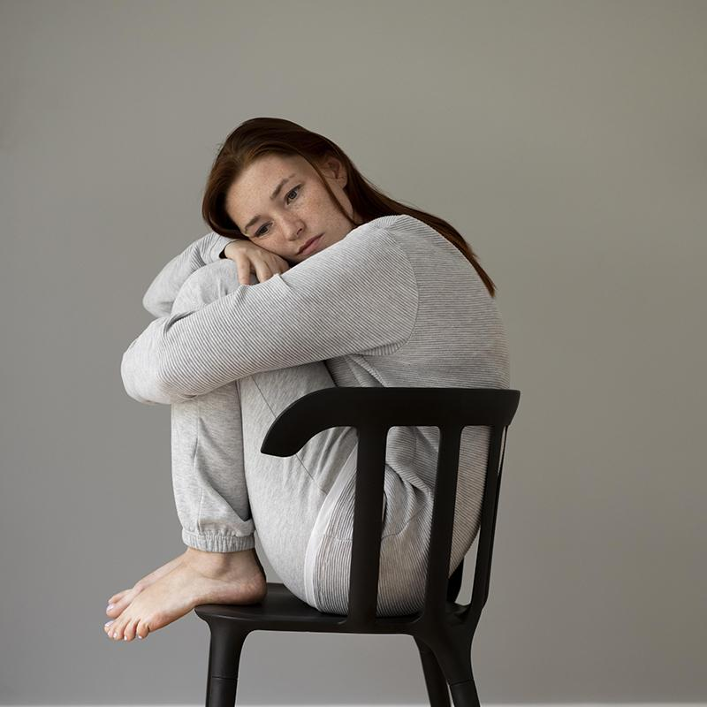
A picture always reinforces
the concept
Images reveal large amounts of data, so remember: use an image instead of a long text. Your audience will appreciate it

Slide 17
Take care of your mental health
Unplug
See a doctor
1
Call friends
3
Stay active
Mercury is the smallest planet
2
Mars is actually a very cold place
4
Venus is the second planet from the Sun
Earth is the planet where we all live

Slide 18
Treatment for mental health issues
Mental health issues | Treatment
Anxiety/depression | Mercury is the smallest planet
Schizophrenia | Venus is the second planet from the Sun
Bipolar disorder | Mars is actually a very cold place
OCD/PTSD | Neptune is very far from the Sun
Suicide | Pluto is now considered a dwarf planet

Slide 19
150,000
Big numbers catch your audience’s attention

Slide 20
9h 55m 23s
333,000
386,000 km
is Jupiter's rotation period
Earths is the Sun’s mass
is the distance between Earth and the Moon

Slide 21
This is a map
Jupiter
Venus
It’s the biggest planet in the Solar System
Venus is the second planet from the Sun
Saturn
Mars
Saturn is a gas giant and has several rings
Despite being red, Mars is a cold place

Slide 22
Emotional first aid
Guilt
Venus is the second planet from the Sun
Trauma
Brooding
Mercury is the smallest planet of them all
Mars is actually a very cold place
Loneliness
Rejection
Jupiter is the biggest planet of them all
Neptune is the farthest planet from the Sun

Slide 23
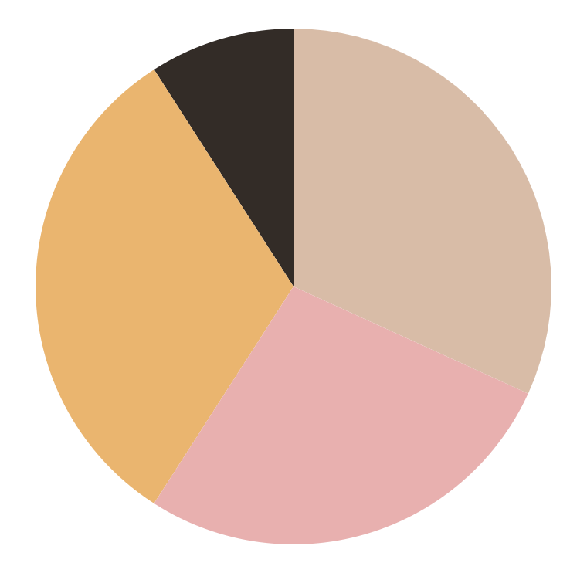
Give statistical data
30%
35%
Venus
Mercury
Venus is the second planet from the Sun
It’s the closest planet to the Sun
5%
30%
Neptune
Mars
It’s the farthest planet from the Sun
Mars is actually a very cold place
Follow the link in the graph to modify its data and then paste the new one here. For more info, click here

Slide 24
Practical exercise
Identify the trigger
…
…
…
Symptoms that you feel
…
…
…
Behaviour during the situation | Alternative positive behaviour
… | …
… | …

Slide 25

Desktop software
You can replace the image on the screen with your own work. Right-click on it and then choose "Replace image" so you can add yours

Slide 26
Thanks!
Do you have any questions?
youremail@freepik.com | +91 620 421 838 | yourcompany.com
Please keep this slide for attribution

